Slide 1
V3D1
WEEK 4a
2D Object picking

Slide 2
Object picking
To make our scenes more intuitive, we want users to be able to select objects by simply clicking on them
This is called (object) picking
The question is:
  How can we determine which object is under the mouse?
In general 3 methods are available:
  Color coding
  Name stack
  Ray picking

Slide 3
Method 1: Color coding
After rendering the scene in the normal way:
  Give every object a unique color
  Turn off lighting, anti-aliasing, texturing
    In this way the original colors will not be changed
  Render all objects again, but only in the backbuffer (so it will not be visible)
  Read from the backbuffer, exactly the pixel that the user clicked on
  Check the color of that
    This will tell us which is the closest object on that pixel

Slide 4
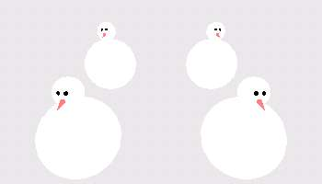
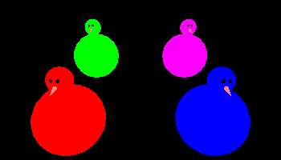
Method 1: Color coding
Visible image:
Color coded image in
backbuffer:

Slide 5
Method 1: Color coding
Advantages
  Simple to implement
  Gives exact results
Disadvantages (depending on the needs):
  You have to click exactly on the object, or it will not be found
  You can only find the closest object, objects hidden behind other objects will not be found

Slide 6
Method 2: Name stack
After rendering the scene in the normal way:
  Give every object a unique name (usually an int)
  Define a small viewport around the mouse position (just a few pixels wide and high)
  Render all objects again to the small viewport, in a special mode (select mode)
  Each time when an object is inside the viewport, its name is put in a list, together with its z-distance
  Finally that list is returned to the application
  Application can filter out the required object (usually the one with the smallest z-value)

Slide 7
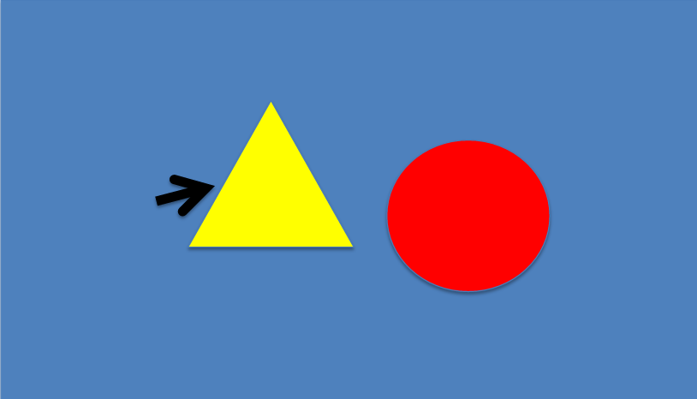
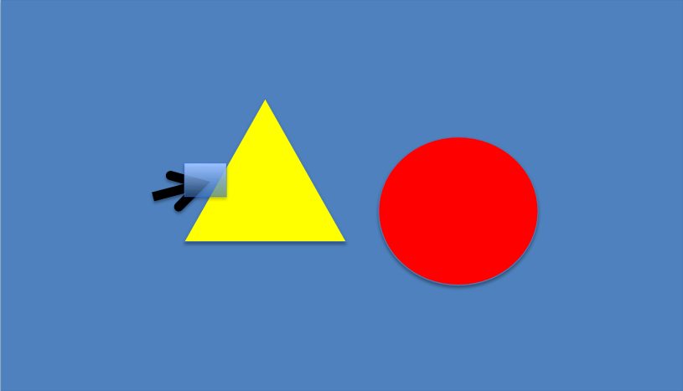

Method 2: Name stack

Slide 8
Method 2: Name stack
Example
Advantages
  Picking doesn’t have to be exact
    When an objects maps inside the chosen viewport around the mouse position, it will be found
  Picking can be made exact
    Choose a viewport of only 1 pixel
  It is possible to ignore certain objects
    Skip those objects when filtering the list

Slide 9
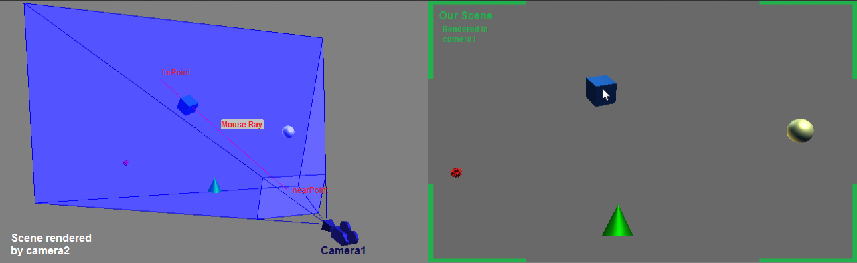
Method 3: Ray picking (ray casting)
Define the ray from the eye position through the selected pixel into the virtual world
Calculate which objects are hit by this ray
  Check all objects one by one
  To simplify calculation, use bounding geometry

Slide 10
Method 3: Ray picking
We project a 3D object to a 2D screen by using model, view and projection matrices
  Transforming from model coordinates v to screen coordinates is a matrix multiplication: PVMv
When picking we do the opposite : transform from mouse position m on the screen to world coordinates
  This operation is called Unprojection
    M⁻¹V⁻¹P⁻¹m
Unprojection enables us to create the ray which is needed for Ray picking

Slide 11
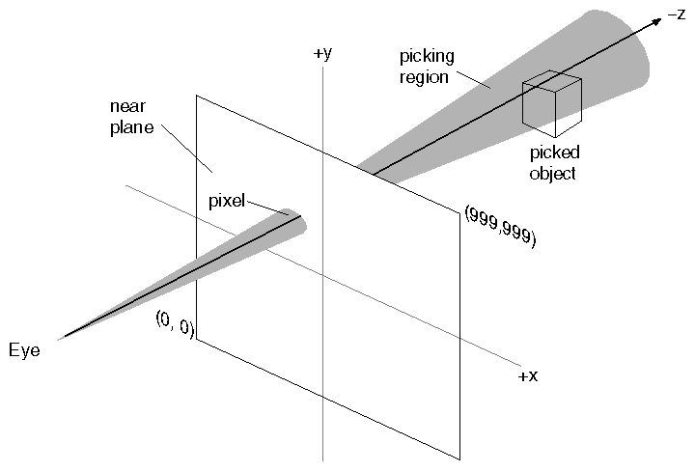
Method 3: Ray picking
With Ray picking, it is difficult to pick a point, line or wireframe object
Instead of a single line, we can use a cone and check if the point or line is inside the cone

Slide 12
Picking in Vizard
object = viz.pick()
  This will use ray picking to find the closest object under the mouse cursor
  Has some options:
    Can also return list of all objects hit by the ray
    Can ignore backfaces
    Can return extra information in a viz.Intersect object:
      Point of intersection, and its normal
      Name of the subnode that was intersected
      Path to the intersected object in scene graph as list of nodes, or list of names (only in Vizard 5)

Slide 13
Variants of picking
You can use any position, instead of mouse position
  object = viz.pick(pos=[x,y])
    This will use ray picking to find the closest object under the specified pixel [x,y]
    Useful if you have another device than the mouse
You can use any line as a ray:
  object = viz.intersect(p1,p2)
    This will use ray picking to find the first object on the line segment from p1 to p2
    Acts like a kind of stick with which you can select objects
    Or if you fire a gun, you can see which object is hit

Slide 14
From screen into world
line = window.screenToWorld([x,y])
  Returns the line through the eye and pixel [x,y]
  This is the ray that is used in viz.pick([x,y])
  Can be used to draw the ray

Slide 15
Put an object on mouse position
Where to put the object in 3D space?
Let’s say 10 meter from origin:
  Define vertical plane 10 meter from origin
  Find ray with screenToWorld
  Find intersection between plane and ray
  Put object on that point

Slide 16
From 3D point to screen
p = window.worldToScreen([x,y,z])
  Creates a ray from the eye to [x,y,z]
  Returns the pixel where that ray intersects the screen
  Useful if you want to draw a 2D object (like a text) next to an object

